Slide 1
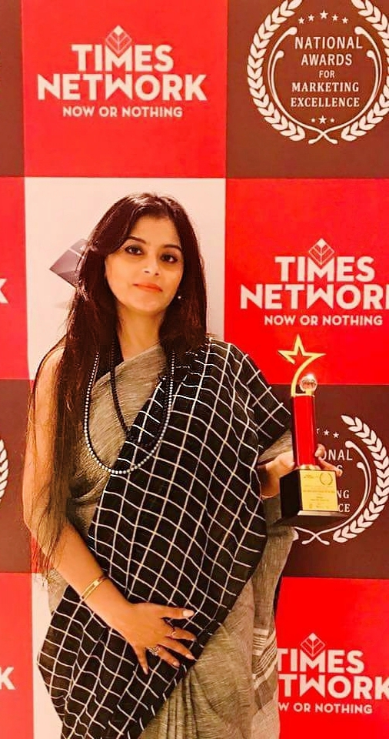
A short introduction of Debjani Mookherjee
A marketing professional from Symbiosis Pune and IIM Kolkata with more than 17 years’ experience in corporate branding, business development, PR and Real estate Marketing & Sales. A digital marketing professional from MICA. Presently she is the senior Vice President of BNRI (Urbana). She loves to introduce herself as an intrapreneur (An inside entrepreneur within a corporate who has the authority to bring positive changes).
Joined in 2007 as GM marketing she is currently working as Sr. Vice President in Bengal NRI Complex Ltd Looking after as Head Marketing and Sales and Facility Head for the Project known as Urbana. A 60 lacs sq. ft project is now the most sought after address and home of many celebrities like Bengali film actresses Suboshree, Srabanti, Paayel. Film Directors like Arindam Sil, Raj Chakraborty, Industry Stalwarts like CS Ghosh, Ravindra Chamaria , Sagar Daryani and many more.

Slide 2
She heads the brand/product strategy for new products/services and leading market launches, including all the marketing channels (ATL, BTL, CRM, research, media relation and PR, digital marketing, events, etc.). Under her Marketing Excellence and supervision the project is 90% sold within 4 years of launching date (April 2010) and now home for 900 plus families.
Apart from Sales and Marketing following are the direct responsibilities of following verticals: Customer Centricity, Facility Management, collections, post sales events and activities, property hand over and snagging, Legal, Security, Landscape and Interior divisions and CSR.
A Team of 50+ Direct employees and 150+ indirect outsourced man power reports to her
Average years of working with her of each member of her team is 7 years plus .

Slide 3
The CSR activities
CSR is another wing which interests her the most as this is a way how she can give back to society by way of her contribution while being with Urbana. The mission and vision been created by her and she is the flag bearer of the idea that starts with “Change your world”.
She is actively involved with the CSR activities of BNRI and Urbana along with an NGO Dakshini Prayas for last 10 years which is based in Mundapara and Anandapur area which is providing holistic education to 400+ students without any Govt. aid under the umbrella of Satyabriti Madurdaha Vidyalya. Girl Childs in the adjoining areas who were persuaded by their parents to drop out from school and were working in a street shop or a babu bari. She convinced the parents and made them back to school and were adopted by BNRI with her supervision and goal. Now all of them are either studying with BSC Nursing or doing the graduation. She feels proud when she looks back at them.
While the kids are been taught in the free school (Rs. 35 per month as tiffin contribution) the mothers are given training on education, hygiene and self-reliance. The work and training on the self-reliance part is stitching, embroidery, cloth putlis, newspaper and recycled carry bags, pearl work etc. for the time being.
Another School in the vicinity is Chowbagha High School which is the winner of Reliance Cup and Subrata Cup which is the inter school football tournament and they represented West Bengal and won the trophy. The entire medical facility of the players and their counselling being taken care by her and her Urbana team and professional doctors.

Slide 4
She is the Founder of Upananda , started 4 years back with an aim to give livelihood to women . It’s just not the story fashion of 6 yards but of women empowerment. In association with Dakshini Prayas the underprivileged local women get training while their kids are being taught in Satyabriti Vidyalya. Upananda , the reason of starting this fashion store is to help more underprivileged women not only by helping them to earn money but also to highlight their decision making power and their achievements that are a function of their own empowerment.
Her moto in life, she believes in the following and thus trying to change her world by changing the world.
“You are educated. Your certification is your degree. You may think of it as the ticket to the good life. Let me ask you to think of an alternative. Think of it as your ticket to change the world.”

Slide 5
Worked with Bengal Shrachi from their initials days (2002 to 2005) and within a short span it became a top Brand , outpaced competitors, today Shrachi is one the best known real estate players in Eastern Region.
Launched a 400 acre township , the first FDI project in West Bengal . She was involved from the initial days of setting up their Office in Kolkata and completed the 1st phase of Marketing and Sales in record time i.e. 10 months which included 788 bungalows through effective marketing and sales plan.
2007 onwards handling and launched Kolkata’s most premium Residential and mixed use township developed by 6 top Realty Developers ,on 67 acres of luxury living and achieved the sales in record time and made the Project as a most sought after address in Kolkata though effective Sales/ Marketing plan and Channel sales. Launched in 2010 and within a short span of 4 years sold 90% of the project and by 2015 started delivering Phase 1 . Now 96% sold out and more than 450 families are staying here .
Another key distinctive achievement she feels is the way she has marketed URBANA. Minimum usage of press media, hoardings and effective usage of digital media since 2013 the Sales/Marketing/PR expenses the project is less than 50% of the industry benchmark. It has mentioned as a record in the audit report too. Her customers are her brand ambassadors and that’s the reason of her SUCCESS.

Slide 6
Debjani Mukherjee Sarkar, general manager — marketing of Bengal NRI and Varun Kathotia, director — marketing of Fort Group agreed. “In the past two months, the trend has shown that the market is picking up. The Bengal NRI, however, believes that people should wait for around six months to get an appreciation of about 10 to 15 per cent,” she said. “Land prices have not changed much and unless one can strike a very good deal, it is better to wait another four months before one sells a property,” Kathotia said. Some said in a couple of years, there would be major rise in property prices. “Those who had invested between 2005 and 2007, early 2008 had been the best time to sell off. At the moment, the market is slightly down and it is the right time to buy rather than sell. By 2011, there will be another 20 to 30 per cent jump in the market and that will be the ideal time to sell,” said Mayank Saksena, associate director of Joneslang Lasalle Meghraj.
When She is in News
http://www.indianrealtynews.com/kolkata/page/38
Candid Communication is a professionally managed PR agency based in Kolkata. Their strategic tie-ups with some of the renowned PR agencies in other metros and mini-metros provide clients with an all India support. Their list of clients include The Indian Football Association, Khadim Shoes, Apollo Health and Lifestyle Ltd, Information and Technology Department, Government of West Bengal, and Khaitan Industries, among others.
Elaborating on the account win, Debjani Mukherjee Sarkar, Marketing Manager, Kolkata West International City Pvt Ltd, said, “This is going to be the largest FDI in West Bengal till date. So, we were looking for a PR agency who could guide us to get a maximum mileage. Candid Communication has already worked with one of our partners, Universal Success in the past. So, we have unanimously decided to go ahead with Candid.”
https://www.exchange4media.com/
https://news.webindia123.com/news/
articles/india/20170428/3100409.html
The seminar was organized to discuss the burning topic of the implementation of RERA and the concept of professional home inspection services around RERA.
Speaking on the occasion, Mr. Nandu Belani, president of CREDAI, said, "The advent of the path-breaking Real Estate Regulation & Development Act, 2016 (RERA) gave a big boost to the real estate market. It will help both the developers and homebuyers in the process."
Mr. Girja Choudhary, CFO of Emami Infrastructure gave a detailed presentation on RERA, the concept, its key legal provisions and explained how RERA will affect all key stakeholders (developers and home buyers).
"In the light of RERA, the home inspection services will not only boost the morale of consumers but will also provide the real estate developers peace of mind by assuring quality control over work done by contractors / workers," said leading city-based developer, Mr. Dileep Singh Mehta of Multicon Group. "I am happy to see the seeds of the home inspection idea that I had visualised 20 years back now seeing the light of the day at the right time for the real estate industry," Mr. Mehta said.
Ms. Debjani Mukherjee ,Senior Vice President, Sales& Marketing, Bengal NRI Complex Ltd. agreed to this and mentioned that they have already engaged MACJ- ABCHI to conduct home inspection of 250 of their apartments of the premium Urbana Residential Project before handover to the customers.

Slide 7
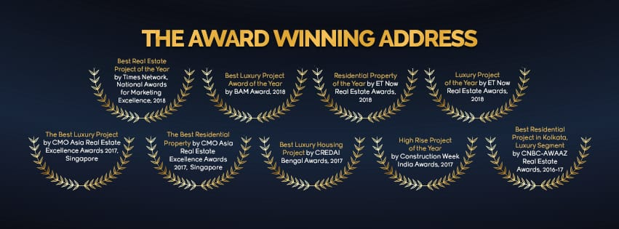
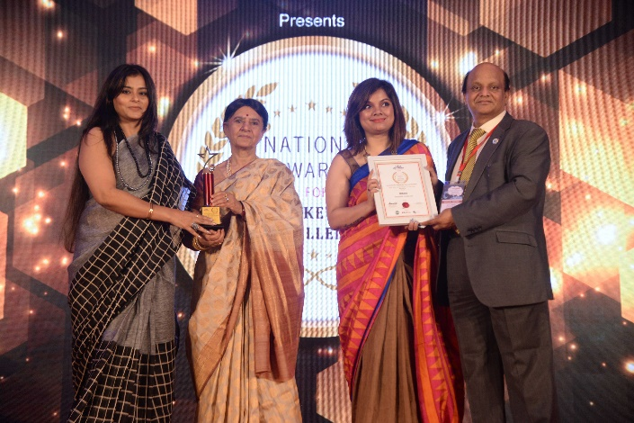
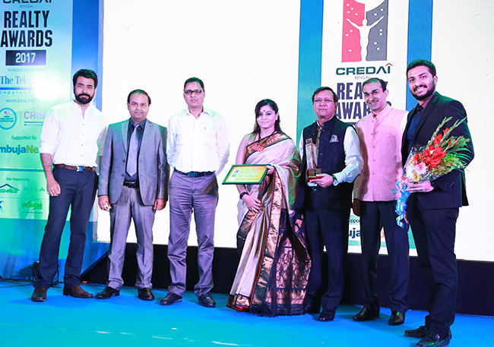
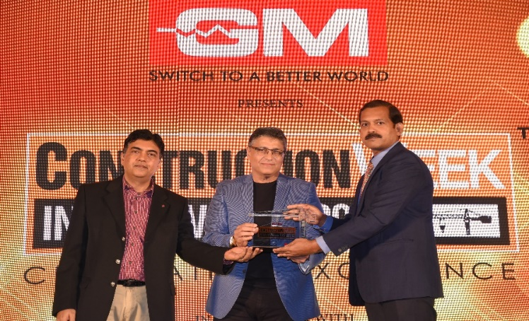
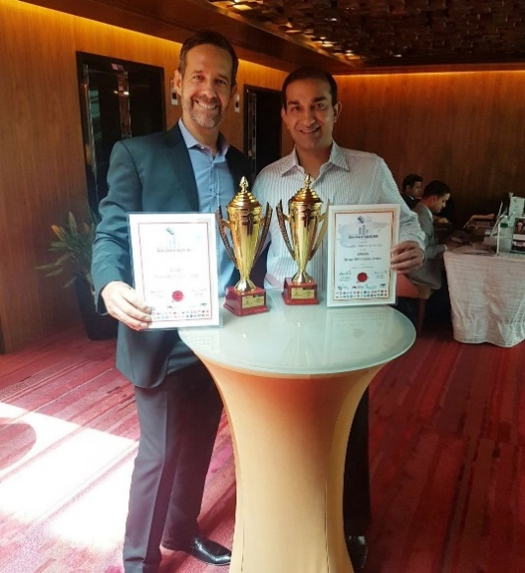
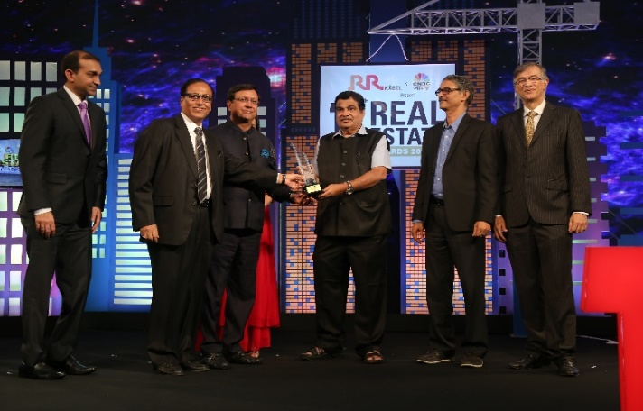
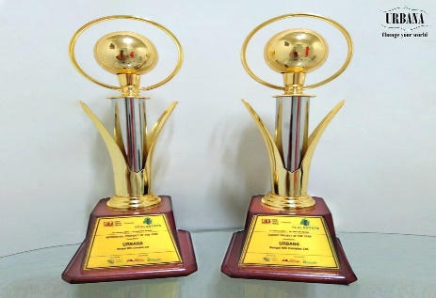
The Awards- Urbana received under her Supervision and guidance

Slide 8
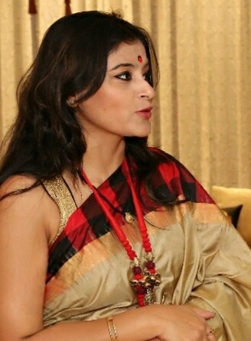
40 years old , mother of 3 girls, she is a marketing professional from Symbiosis Pune and IIM Kolkata with more than 17 years’ experience in corporate branding, business development, PR and Real estate Marketing & Sales. Presently she is the senior Vice President of BNRI (Urbana). She loves to introduce herself as an intrapreneur (An inside entrepreneur within a corporate who has the authority to bring positive changes).
She has done a crash course on marketing from Wharton College, USA while working in BNRI in 2012.
Also she has completed her Executive Development Course from IIM Kolkata (JOKA) with more then 80% marks while handling the project Urbana and bringing up her daughter in 2013.
She has also completed a Digital Marketing Course from MICA after having a twins in 2016 and handing over 30 millions sq. ft in 2018.

Slide 9
Thank you

